Slide 1
Financial Review
Of
The Unaudited Results and Usage through September 30, 2025
As of October 24, 2025

Slide 2
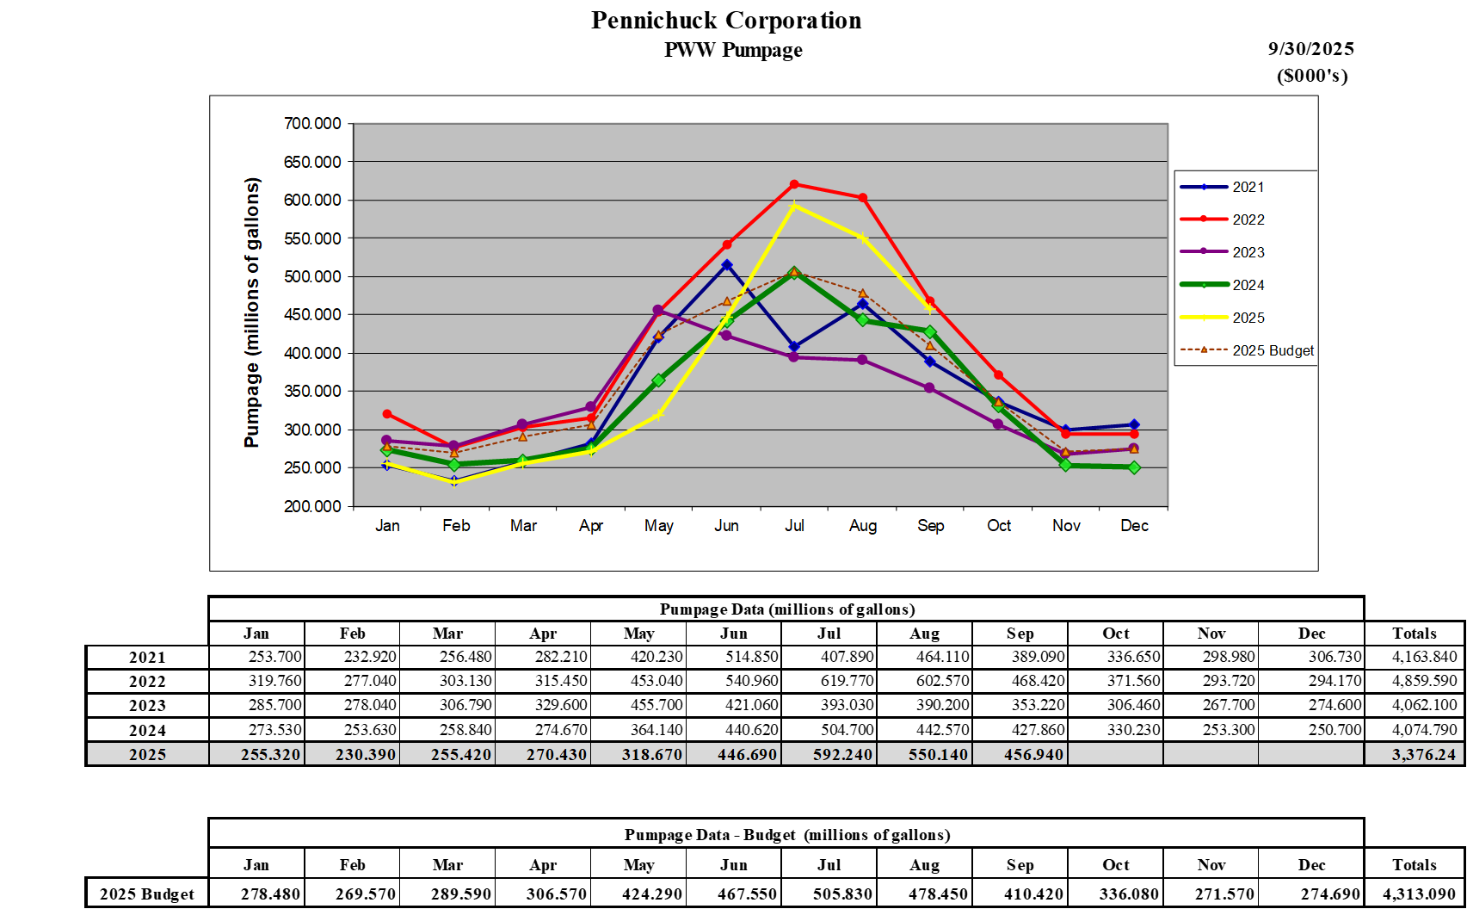
PWW Pumpage

Slide 5
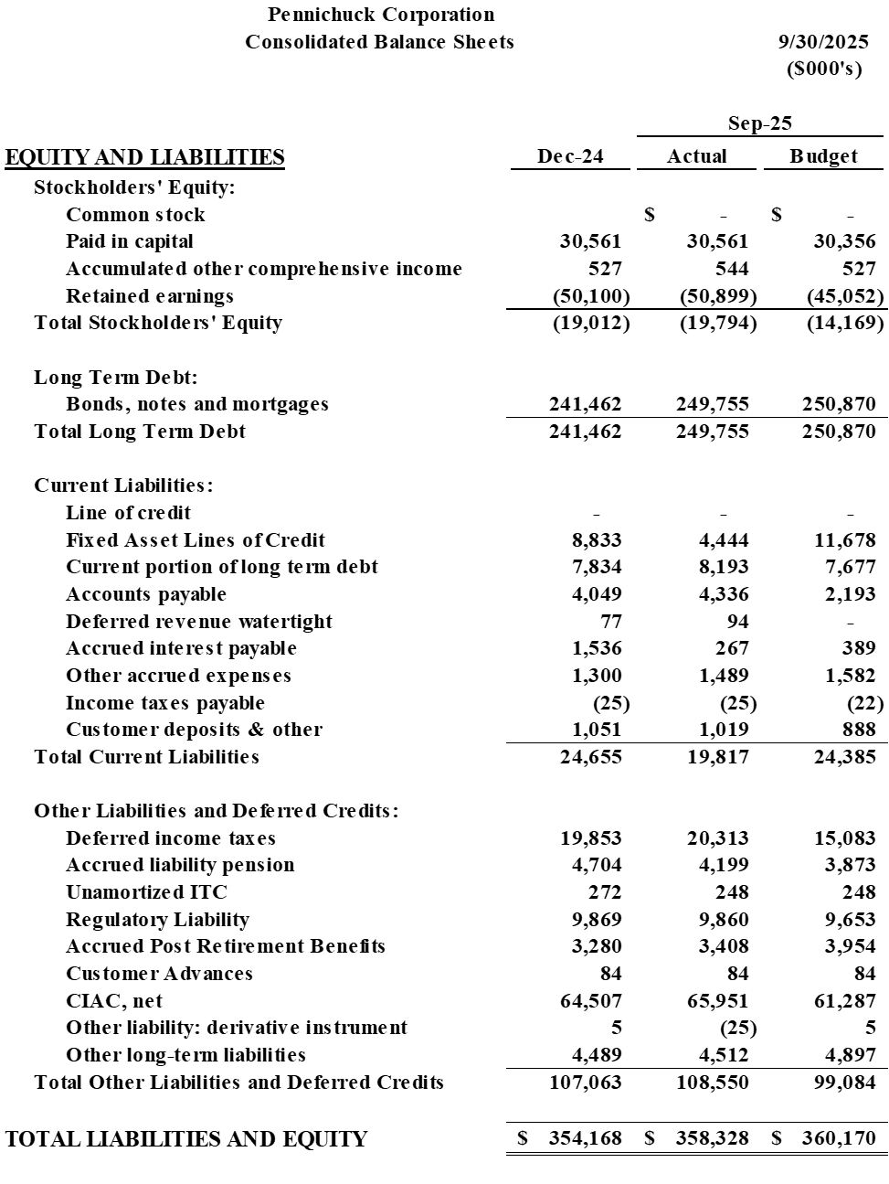

Slide 6
