Slide 1
Financial Review
Of
The Unaudited Results and Usage through July 31, 2025
As of August 22, 2025

Slide 2
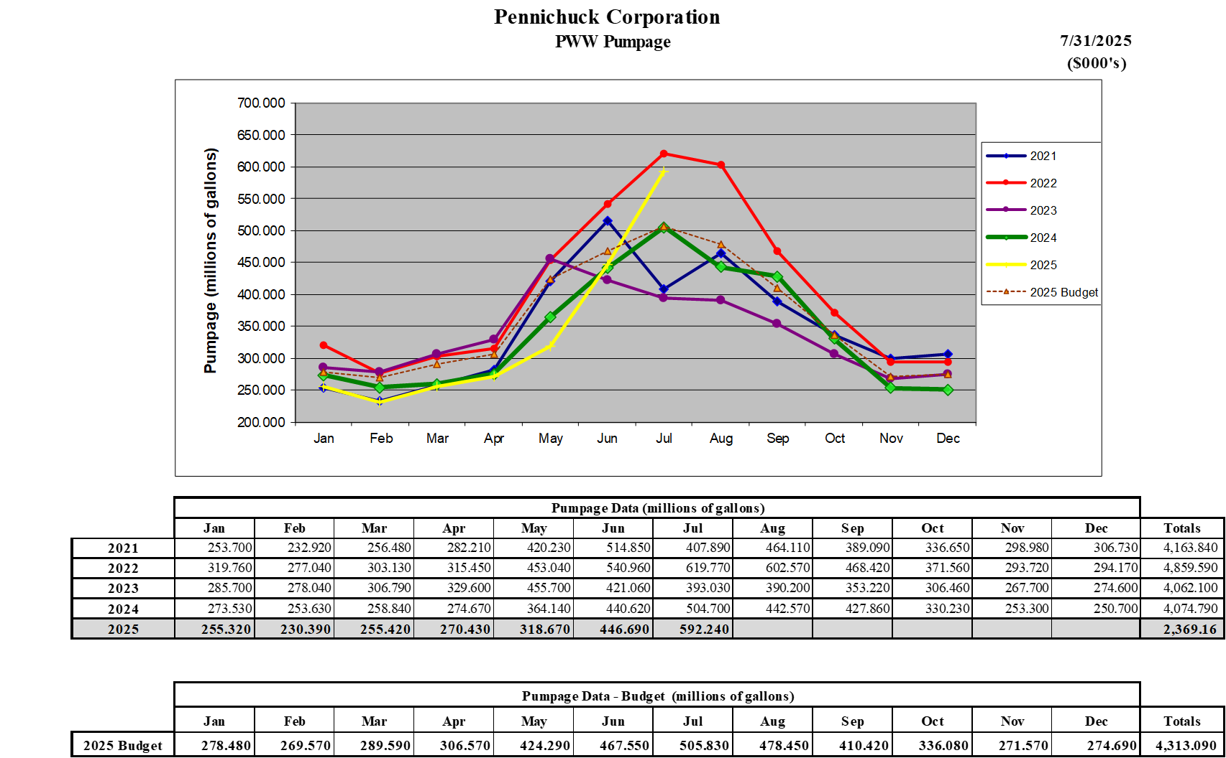
PWW Pumpage

Slide 4
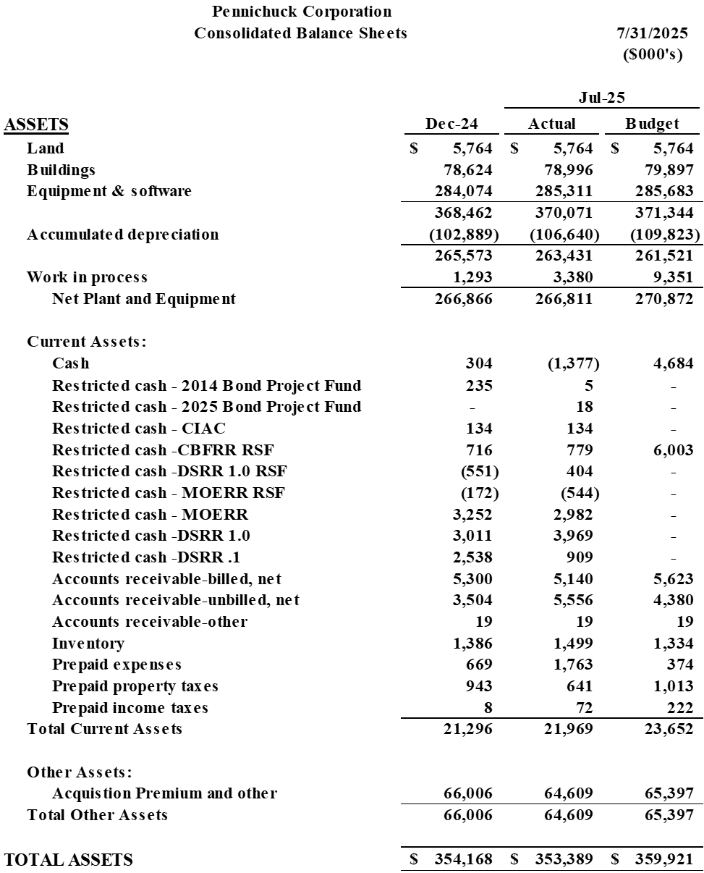

Slide 5
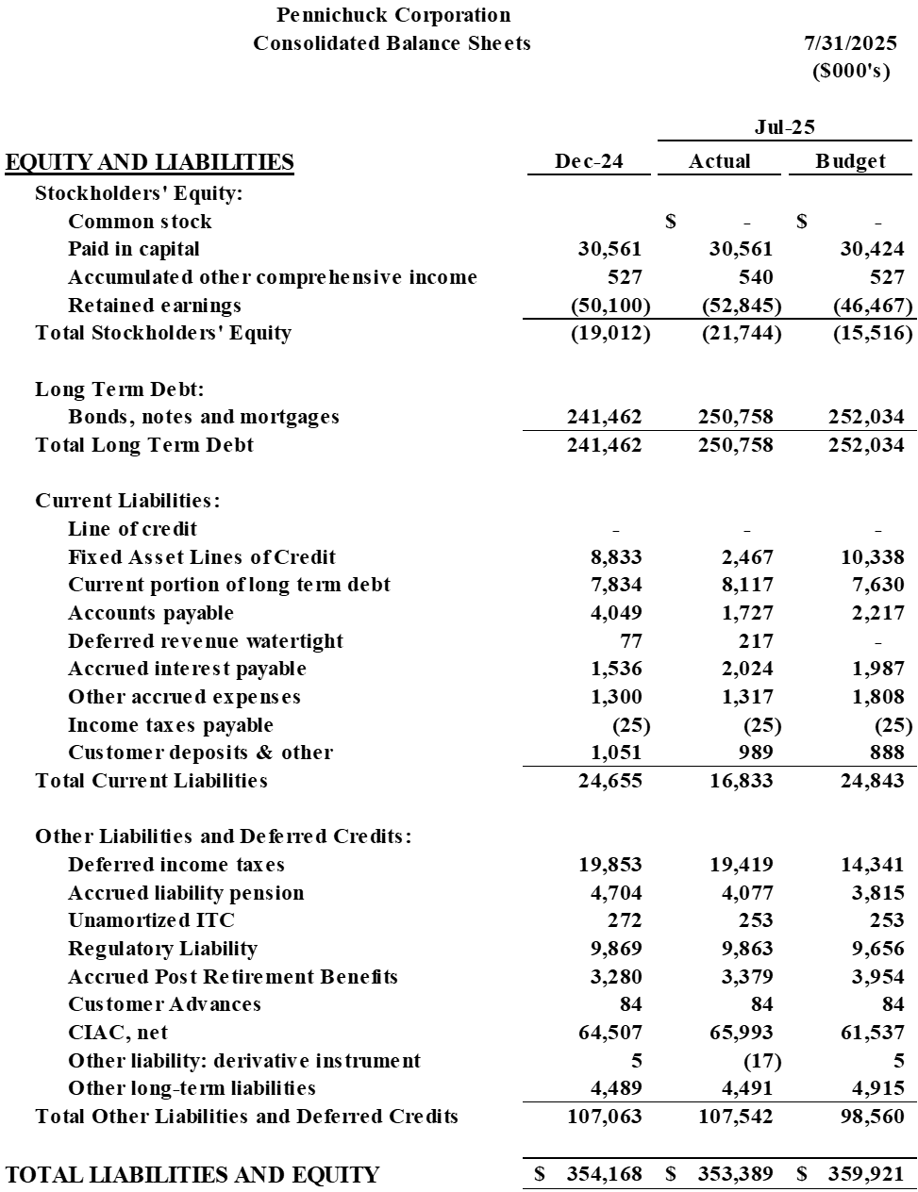

Slide 6
