Slide 1
Financial Review
Of
The Unaudited Results and Usage
through April 30, 2024
As of May 23, 2024

Slide 2
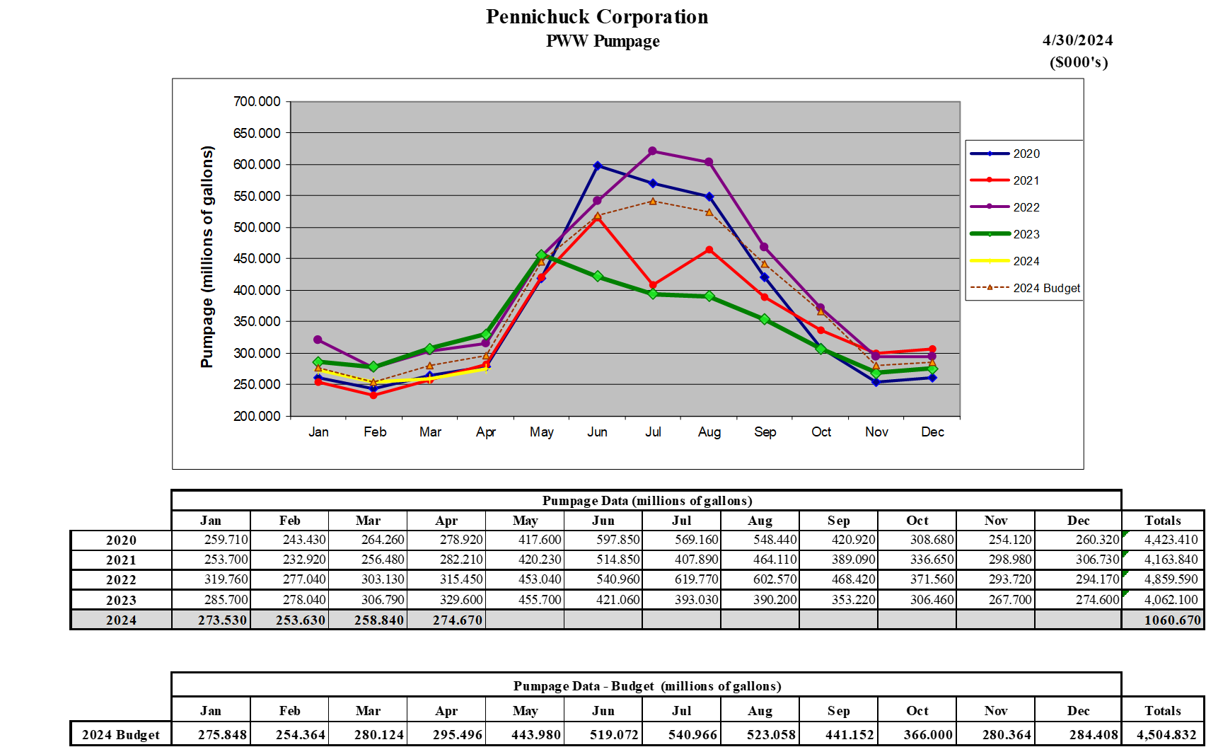

Slide 4
4

Slide 5
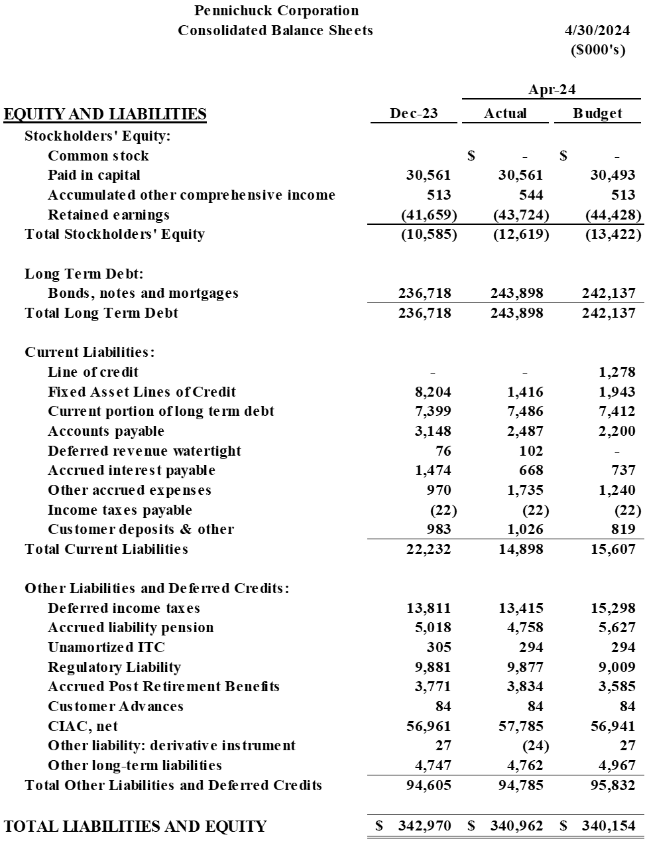

Slide 6
